Slide 1

PVM Mobile App ( Current & New )

Slide 2
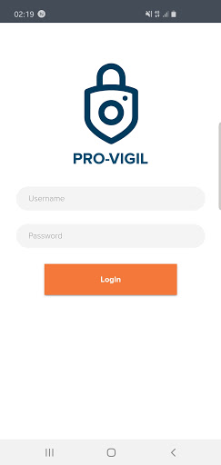
Login Page
Current App

Slide 3
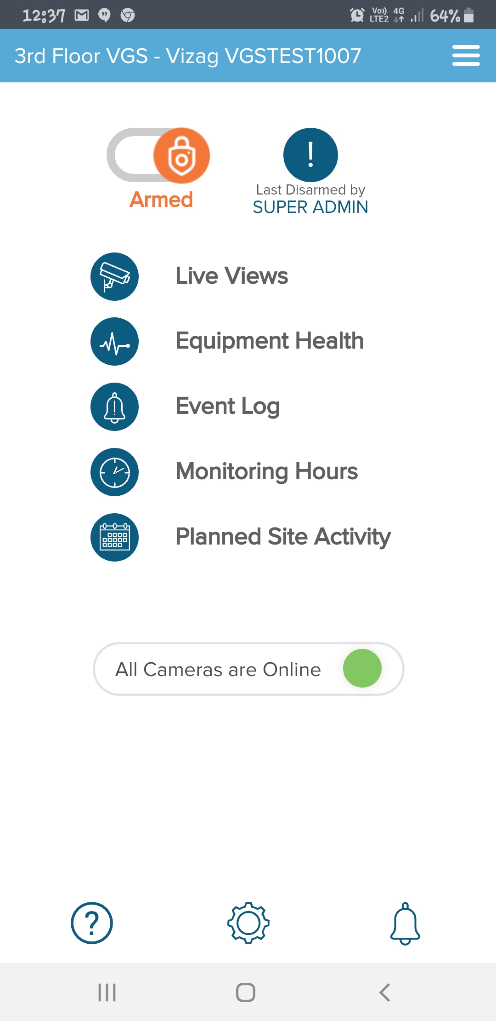
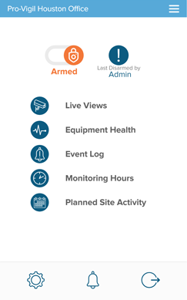
Home Page
Current App
New Screen
Removed “All Cameras are Online “ equipment status.
Merged Report a Problem section into Settings
Added Logout Icon to the Homepage.

Slide 4
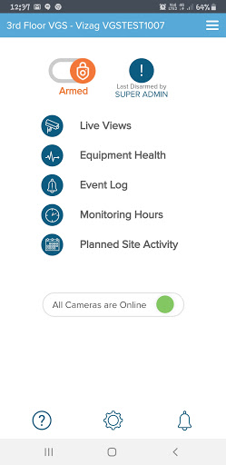
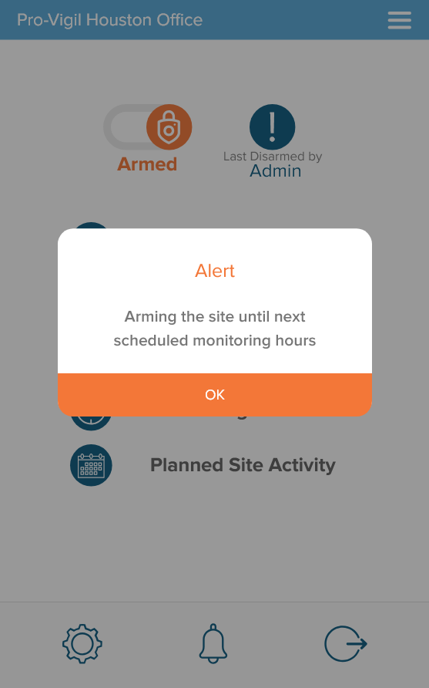
Arm
Current App
New Screen
Notify with an alert message when we Arm a Site

Slide 5
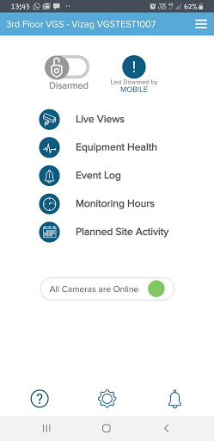
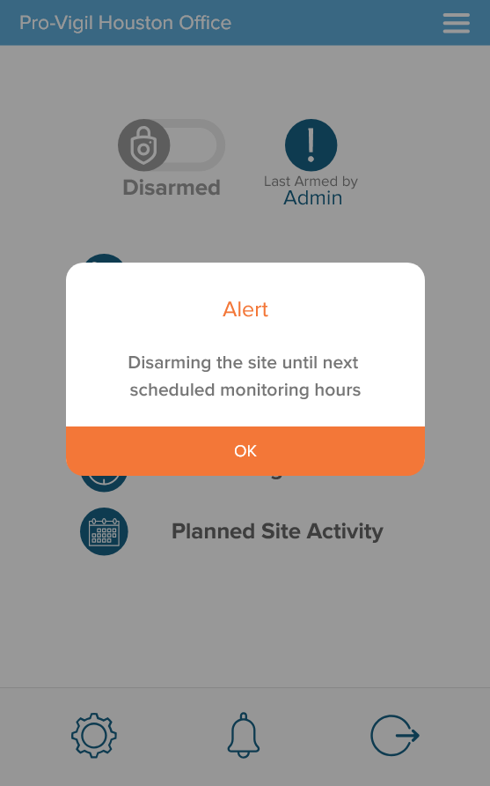
Disarm
Current App
New Screen
Notify with an alert message when we Disarm a Site

Slide 6
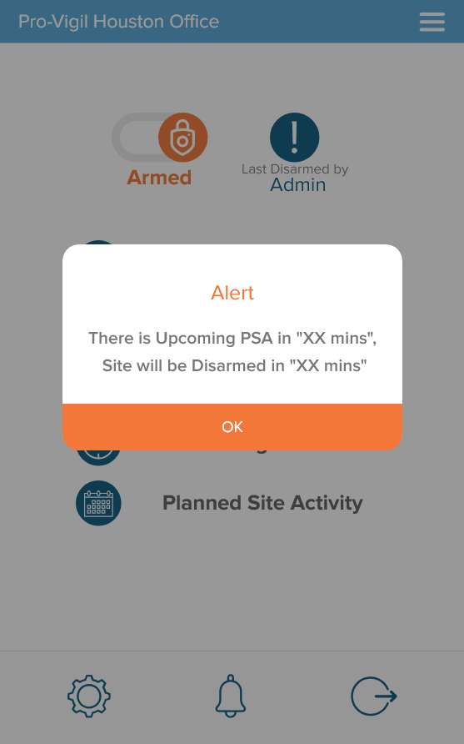
Disarm_PSA
Current App
New Screen
Site is currently Disarmed and while trying to arm the site, will notify the user about upcoming PSA with duration.
The Duration would change dynamically based on the user action .
Example- If PSA starts in 10 mins, then the text would be displayed as “ There is upcoming PSA in “10 mins”,Site will be disarmed in “10 mins”.

Slide 7
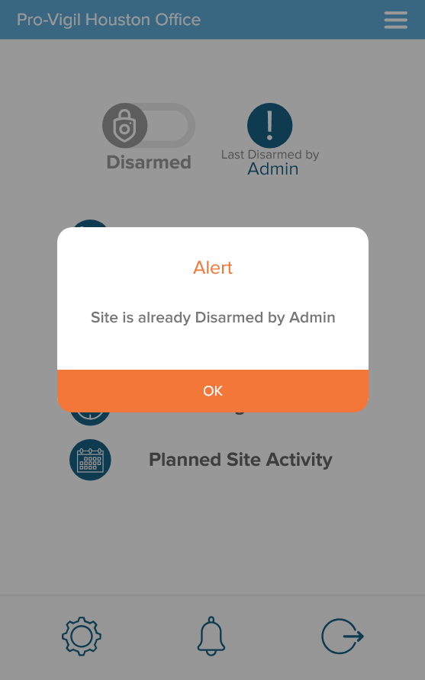
Disarm Alert
Current App
New Screen
If Site is disarmed by Admin from SI page and If user try to Disarm from Mobile app- same time, then a Popup message should show 'Site is already Disarmed by Admin'.

Slide 8
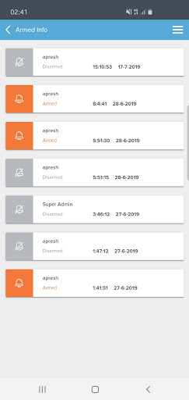
Last Arm /Disarm History
Current App

Slide 9
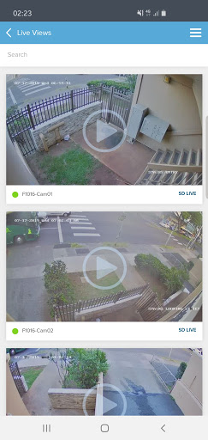
Live Views
Current App

Slide 10
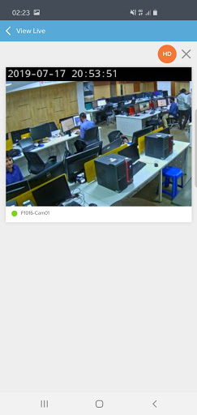
View Live_SD View
Current App

Slide 11
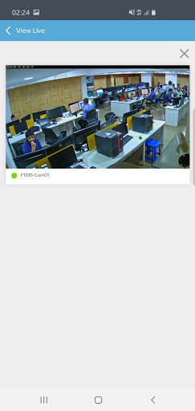
View Live_HD View
Current App

Slide 12
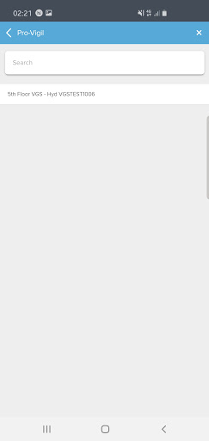
Search for a Site
Current App

Slide 13
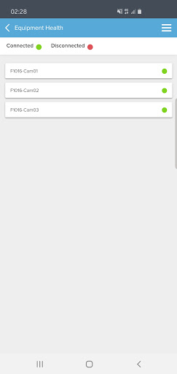
Equipment Health
Current App

Slide 14
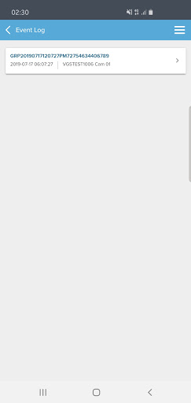
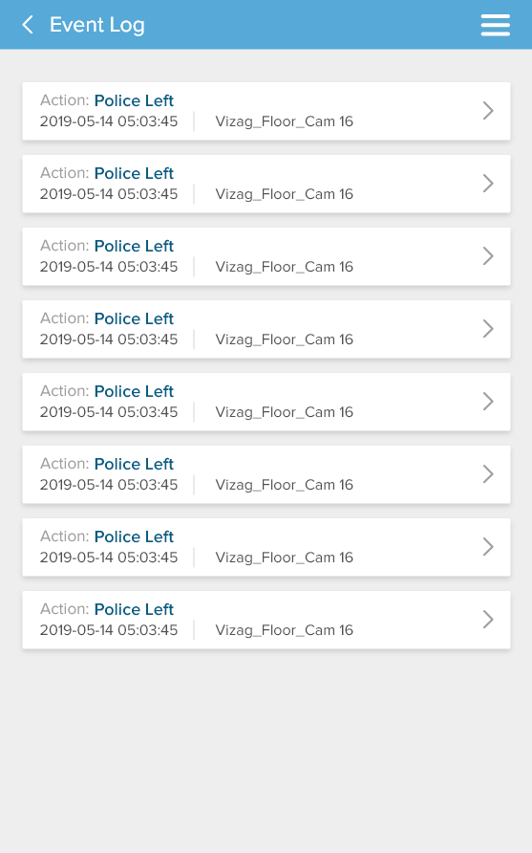
Event Log
Current App
New Screen
Replaced Group Id with the Action Field
On clicking the item, the videos related to that event will be displayed

Slide 15
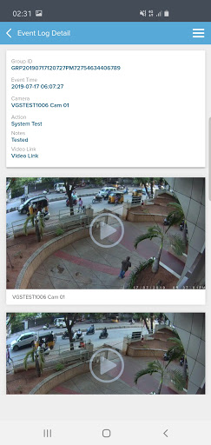
Event Log_1
Current App
Video Link will be removed.
The Videos associated with this event will be displayed below.

Slide 16
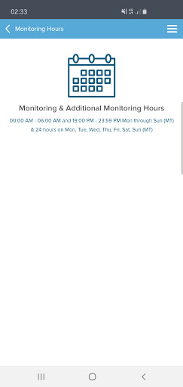
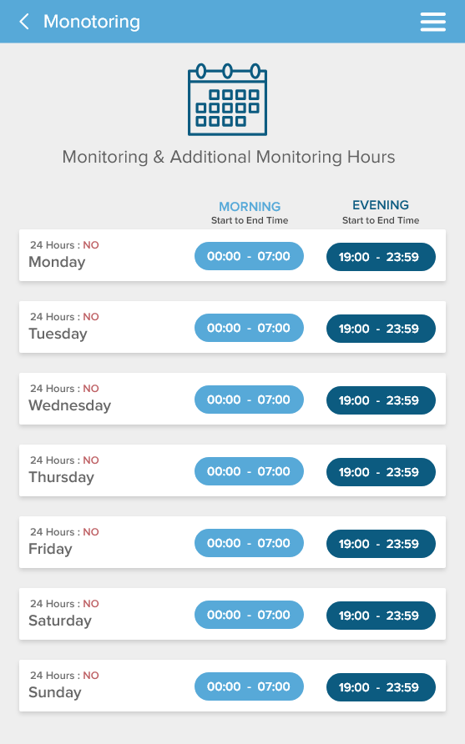
Monitoring Hours
Current App
New Screen
Represented data as per the daily schedule.

Slide 17
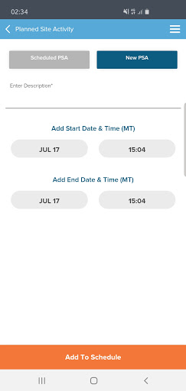
Planned Site Activity(PSA)
Current App

Slide 18
Schedule PSA
Current App

Slide 19
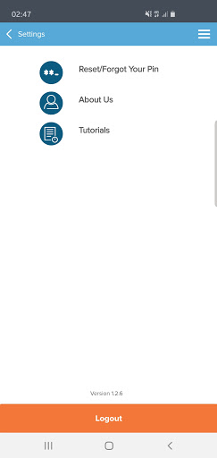
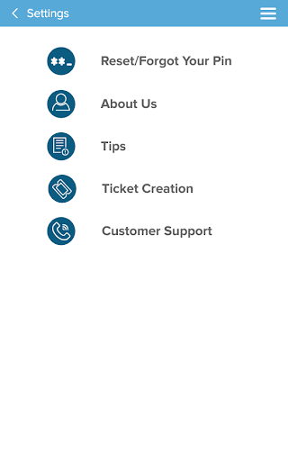
Settings Section
Current App
New Screen
Tutorials is renamed to “Tips”
Added Ticket Creation option to this section
Added Customer Support option to this section.
On Clicking Customer Support , a call
will be placed to the customer support
number
Removed ‘Logout’ from this page and moved to Homepage.

Slide 20
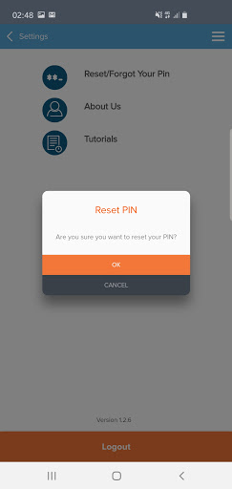
Reset/Forgot your Pin
Current App

Slide 21
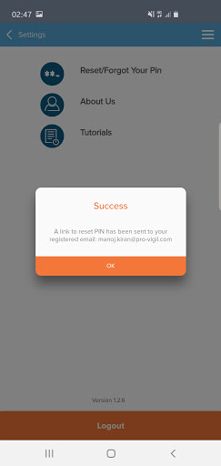
Reset Pin - Confirmation
Current App

Slide 22
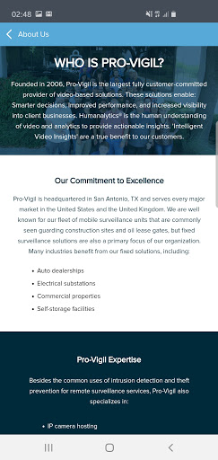
Settings- About Us
Current App
This information will be taken from Pro-Vigil website. Everytime, Pro-Vigil website is changed, the content in this mobile app will need to be changed.
Clarification from Marketing Team Needed:
At this moment, all the information is Static, Do you want it to make it dynamic?

Slide 23
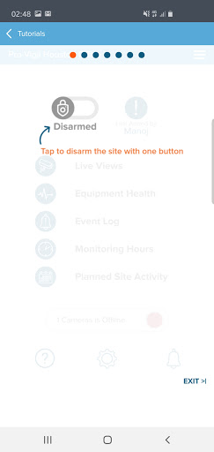
Tips_1
Current App

Slide 24
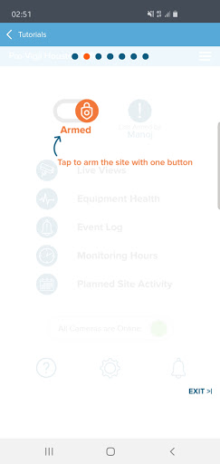
Tips_2
Current App

Slide 25
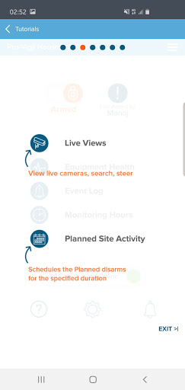
Tips_3
Current App

Slide 26
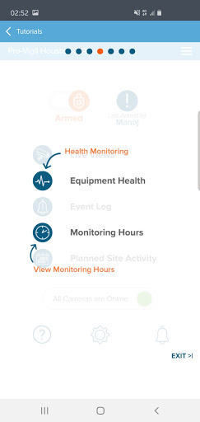
Tips_4
Current App

Slide 27
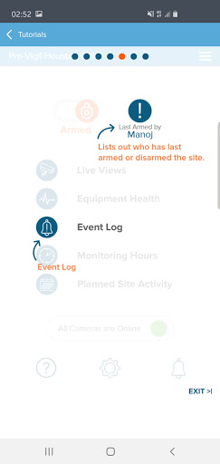
Tips_5
Current App

Slide 28
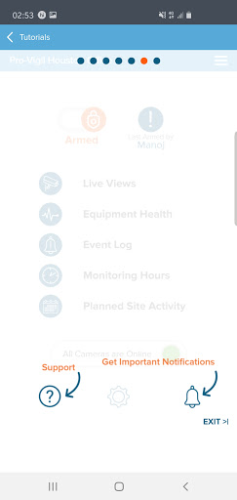
Tips_6
Current App

Slide 29
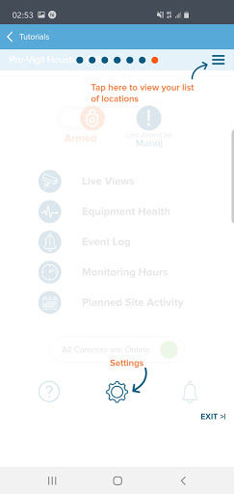
Tips_7
Current App

Slide 30
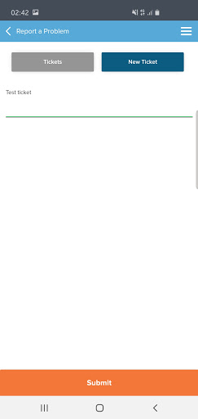
Report a Problem_Ticket Creation
Current App

Slide 31
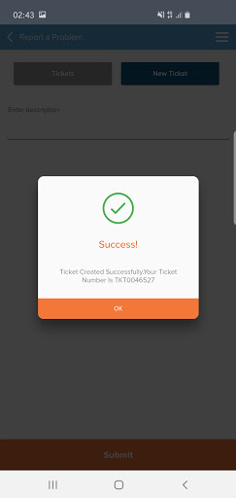
Report a Problem- Ticket Creation_Success
Current App

Slide 32
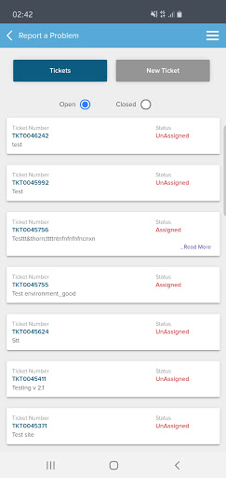
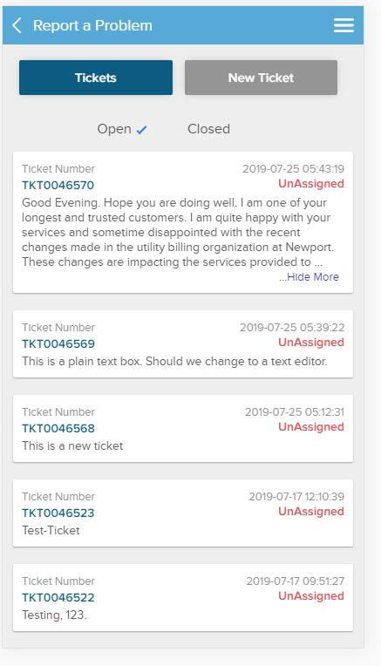
Report a Problem- Ticket List
Current App
For Ticket description, 150 characters will be displayed. When text is more than 150 characters, ‘View more’ button will be applicable.

Slide 33
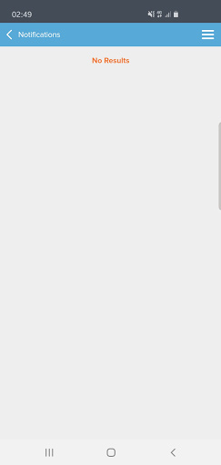
Notifications/Billing Information
Current App

Slide 34
Clarifications needed from Marketing Team
S.No | Amendments | Comments
1 | Home Page - ‘Logout' icon at bottom of home screen instead on settings screen
2 | Home Page - Merge Help section to under ‘settings’ section,, matching with the site branding(Ticketing system)
3 | Home Page - Instant Disarm- Notify user 'Disarming the site until next scheduled monitoring hours'
4 | Home Page - Instant Arm- Notify user 'Arming the site until next scheduled monitoring hours'
5 | Home Page - Within Monitoring hours if site is Disarm and user try for Instant Arm and if there is an upcoming PSA within 60 mins - Pop up Message --> There is Upcoming PSA in "0-60 mins", Site will be Disarmed in "0-60 mins"(This duration will change to display according to the PSA time, eg: 20min and 10min)
6 | Camera Live Views - Only HD stream and remove SD stream
7 | Home Page - Check possibility to implement 3D touch(Pressure touch on any functionality on Homepage, it should list the help guide)
8 | About Us- Pro-vigil website, currently its Static Page. If needed it can be dynamic sync
9 | Notifications- Its data driven decision to be made by Marketing team as per comparative analysis - as in what customer prefers to see in Notification/alerts
10 | Monitoring Hours Page- Better representation[tabular format], MOC screens with Existing and new recommendations
11 | Settings Page - Help Desk -Ticket creation along with Direct Dial in option to Customer Support

Slide 35
Clarifications needed from Enterprise/Indirect
S.No | Amendments | Comments
1 | Allowing to ARM the site outside scheduled Monitoring hours- Is that permissible? how to capture this?
2 | Is Multiple Sites- One login required? , Currently PVM mobile app can have only One account to one login.(Is there any requirement to have multiple sites assigned to one login)

